Slide 1
Storage devices we use everyday
Nyukhalov Denis, IVT 2

Slide 2
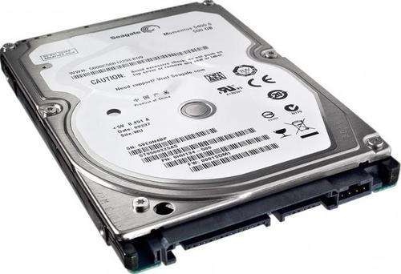
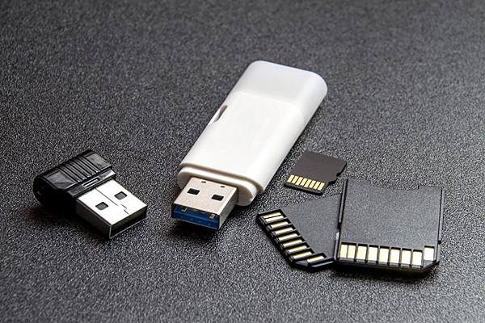
Internal and External storage devices
Internal storage devices mean devices that are embedded in your computer.
An external storage device, is a device that contains all the addressable data storage that is not inside a computer's main storage or memory

Slide 3
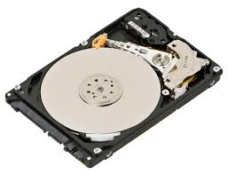
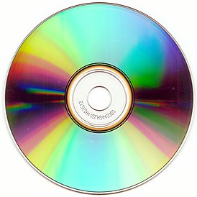
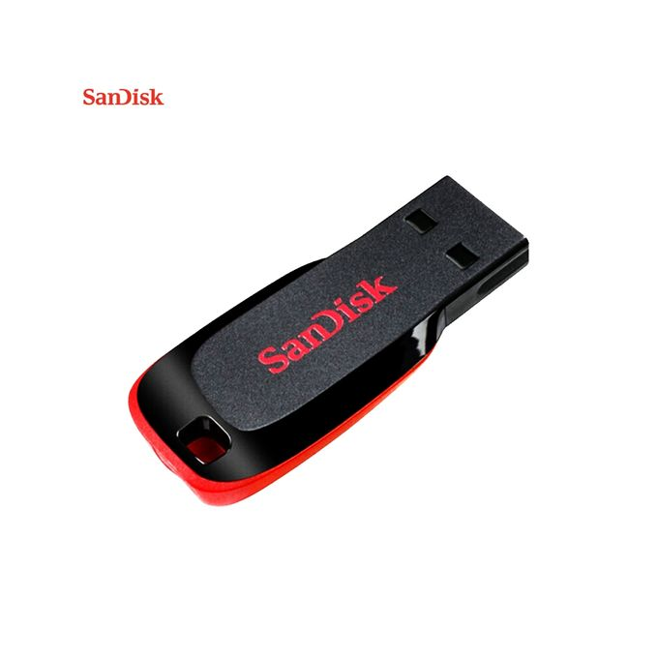
Kinds of storage devices
Magnetic storage devices:
Floppy diskette
Hard drive
Optical storage devices:
CD-R and CD-RW disc.
DVD-R and DVD-RW disc.
Flash memory devices:
USB flash drive
SD card
SSD

Slide 4

Magnetic storage devices
Hard disk drive:
Capacity: up to 16TB
external storage device
Average speed 80-160 mb/s

Slide 5
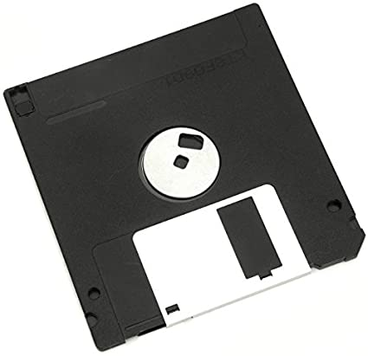
Magnetic storage devices
Floppy disk drive
Capacity: up to 240 MB
external storage device
Average speed 1.4 mb/s

Slide 6
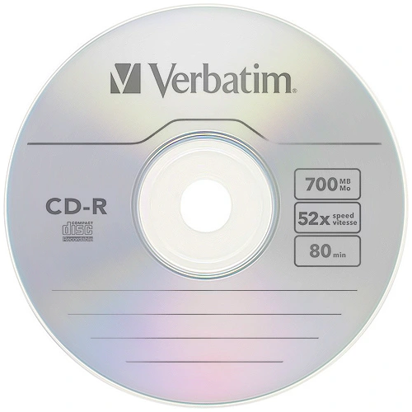
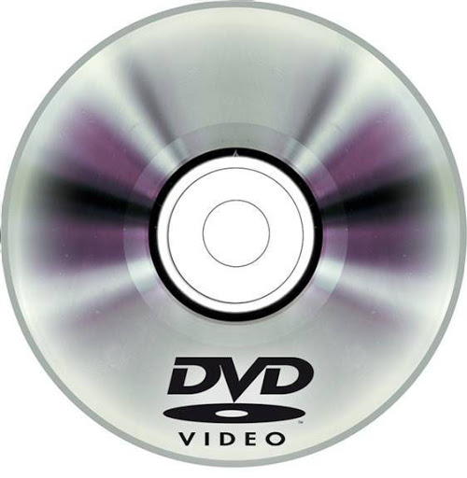
Optical storage devices
They are pretty similar, but DVD is faster and it has greater capacity. They are external storage devices.

Slide 7

Flash memory devices
USB flash drive
Capacity: up to 1 TB
external storage device
Average speed 60 mb/s to 5 gb/s (depends on standard)

Slide 8
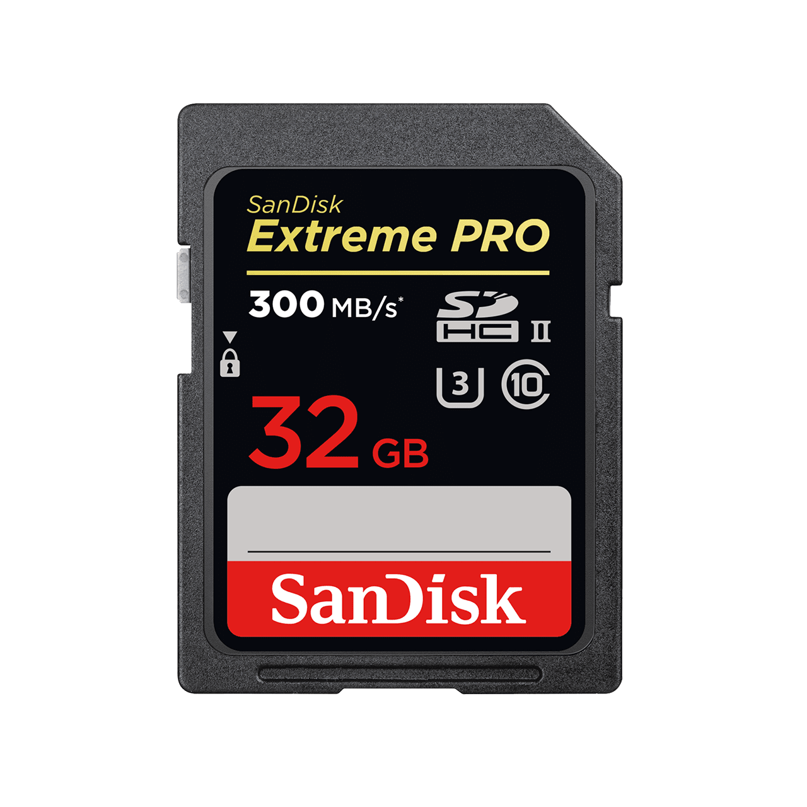
Flash memory devices
SD card
Capacity: up to 2 TB
external storage device
Average speed up to 60 mb/s

Slide 9
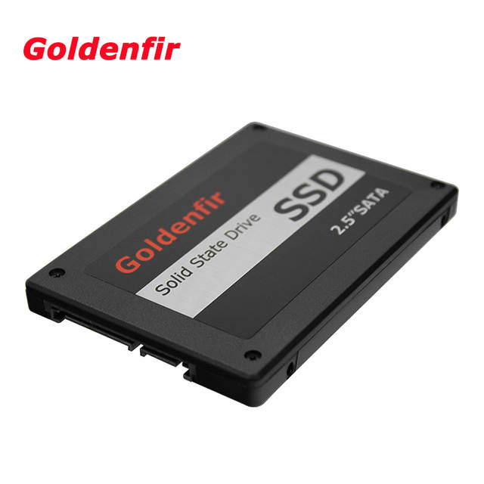
SSD
SSD
Capacity: up to 2 TB
external storage device
Average speed up to 60 mb/s

Slide 10
References
Computer hope
Turbo future

